Slide 1
Board Meeting
Q1 2023
Presenter name (s) Date

Slide 2
What’s working:
What’s not working:
Recent or near-term wins
New processes delivering better than expected
Company achievements
New hires
Broken processes
Negative developments
Product concerns
Potential Risks

Slide 3
Agenda
01
CEO updates
02
Financials
03
Department updates
04
Discussion

Slide 4
Strategic
Learnings
01. CEO UPDATES
01
Updates on current market conditions
02
Expected audience size or changes in ICP
03
Forecasted growth for the approaching quarter
04
Changes in product roadmap/headcount planning
Notes:
In this section, highlight how the market has changed or any other important developments worth noting since the last board meeting.

Slide 5
Company Learnings from Q3
01. CEO UPDATES
Company update #1
01
02
Company update #2
03
Company update #3
04
Company update #4
Notes:
Fort this section, discuss top priorities and initiatives for the coming quarter. Include OKRs that highlight the milestones your team is working to achieve and provide insight on the roadmap ahead.

Slide 6
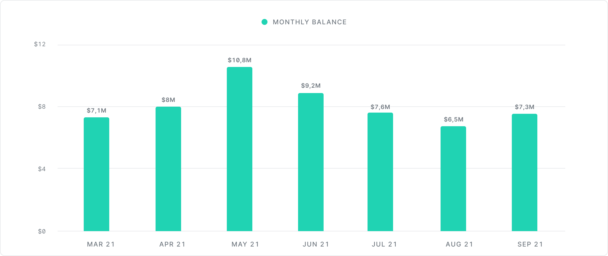
01. CEO UPDATES
Runway
Notes:
Knowing how much cash reserves your company has is essential. Be transparent with investors on your current runway standing so that everyone can align together on how to best allocate funds and extend runway.

Slide 7
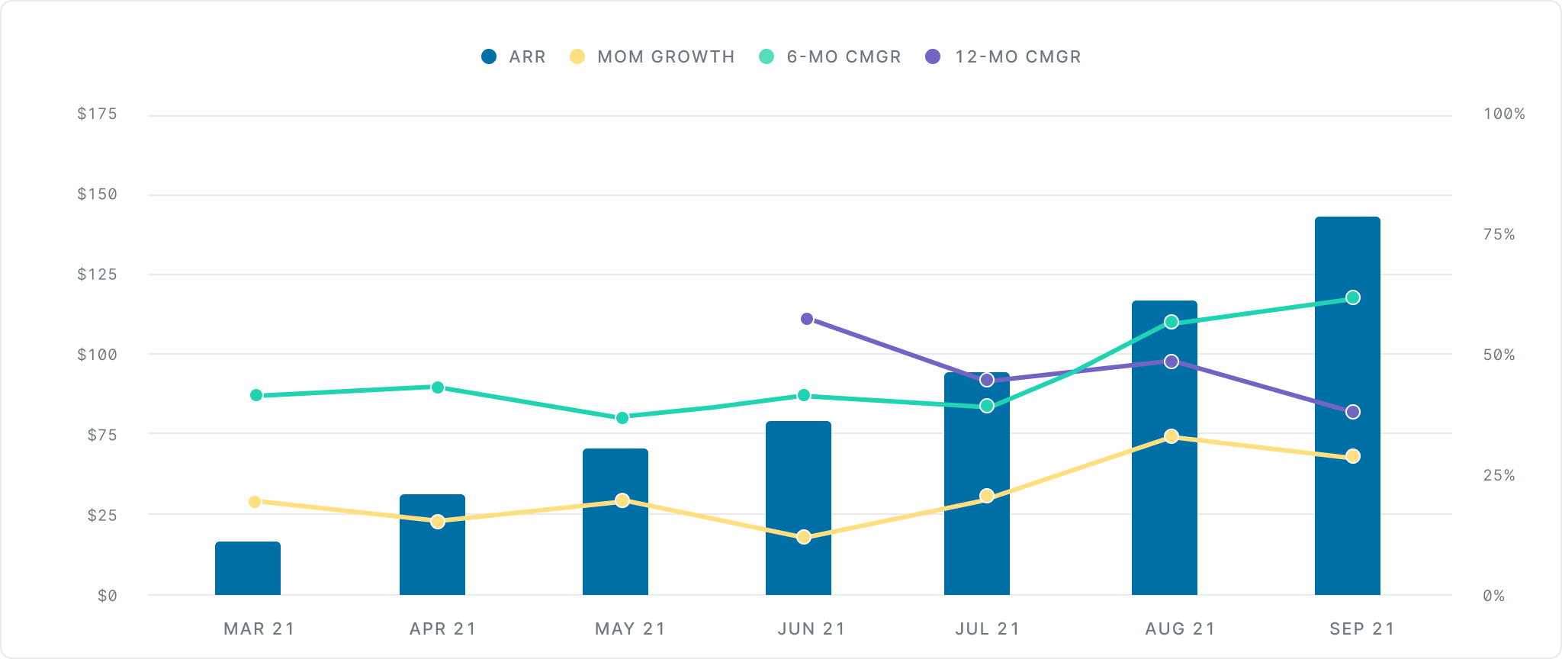
01. CEO UPDATES
Growth
Notes:
Growth and runway are two components that can give an organization an inside look at your company’s health. This metric shows how fast revenue is growing month-over-month. If your company sells annual contracts, use ARR for your primary revenue metric. If you sell monthly contracts, use MRR.

Slide 8
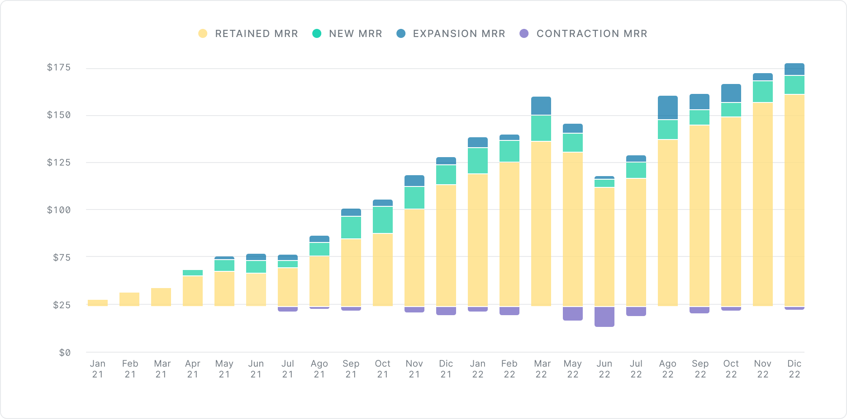
01. CEO UPDATES
MRR

Slide 9
01. CEO UPDATES
Cohorted Retention
 | Month 0 | Month 1 | Month 2 | Month 3 | Month 4 | Month 5 | Month 6 | Month 7 | Month 8 | Month 9 | Month 10 | Month 11 | Month 12
Dec 21 | 100% | 100% | 100% | 100% | 100% | 100% | 100% | 100% | 100% | 100% | 100% | 100% | 100%
Jan 22 | 100% | 99% | 96% | 93% | 109% | 109% | 101% | 107% | 107% | 107% | 107% | 108%
Feb 22 | 100% | 100% | 100% | 100% | 100% | 100% | 100% | 100% | 100% | 100% | 100%
Mar 22 | 100% | 100% | 100% | 100% | 100% | 64% | 64% | 64% | 64% | 64%
Apr 22 | 100% | 100% | 100% | 100% | 100% | 100% | 100% | 100% | 93%
May 22 | 100% | 100% | 100% | 100% | 100% | 100% | 100% | 100%
Jun 22 | 100% | 99% | 99% | 99% | 99% | 99% | 99%
Jul 22 | 100% | 56% | 56% | 56% | 56% | 56%
Aug 22 | 100% | 235% | 275% | 183% | 103%
Sep 22 | 100% | 100% | 100% | 83%
Oct 22 | 100% | 64% | 37%
Nov 22 | 100% | 13%
Dec 22 | 100%
Avg $ Retention | 100% | 92% | 91% | 89% | 89% | 88% | 88% | 88% | 88% | 88% | 89% | 88% | 86%

Slide 10
01. CEO UPDATES
Engagement
Top 10 Customers
 | Users | DAU/MAU | DAU/WAU
Customer 1 | 240 | 38% | 72%
Customer 2 | 190 | 39% | 67%
Customer 3 | 180 | 36% | 69%
Customer 4 | 180 | 31% | 55%
Customer 5 | 135 | 30% | 63%
Customer 6 | 130 | 27% | 86%
Customer 7 | 125 | 28% | 71%
Customer 8 | 120 | 42% | 60%
Customer 9 | 100 | 20% | 100%
Customer 10 | 90 | 17% | 67%
Notes:
DAU/WAU and DAU/MAU are used to measure engagement. These metrics are helpful to see engagement among your top 10 customers or gain a greater understanding of workday usage.

Slide 11
01. CEO UPDATES
Summary KPIs
 | Q1 2021 | Q2 2021 | Q3 2021 | Q4 2021 | Q1 2022
New Business ARR | 90,000 | 140,000 | 160,000 | 180,000 | 250,000
Expansion ARR | 30,000 | 50,000 | 50,000 | 60,000 | 85,000
Churn ($) | 10,000 | 0 | 10,000 | 20,000 | 20,000
Net New ARR | 110,000 | 190,000 | 200,000 | 220,000 | 320,000
Total ARR | 1,110,000 | 1,300,000 | 1,500,000 | 1,720,000 | 2,355,000
Burn | 330,000 | 410,000 | 440,000 | 505,000 | 580,000
Burn Multiple | 3.0X | 2.2X | 2.2X | 2.3X | 1.8X
ACV | $600 | $700 | $730 | $750 | $833
CAC | $1,667 | $1,600 | $1,400 | $1,300 | $1,150
Payback (Months) | 6 | 5 | 4 | 3.5 | 2.5
Net Dollar Retention | 154% | 145% | 145% | 130% | 137%
Logo Retention | 88% | 95% | 95% | 91% | 90%
Notes:
KPIs help paint a clear picture of how an organization is performing. By checking the health of a business, leaders within an organization can see where they are succeeding and where they need to improve.

Slide 12
Financials

Slide 13
($000s) | 2020A | Q1 2021A | Q2 2021A | Q3 2021A | Q4 2021A | 2021A | Q1 2022A | Q2 2022E | Q3 2022E | Q4 2022E | 2022E | 2023E
Net New ARR | 0 | 40 | 175 | 205 | 240 | 240 | 955 | 305 | 400 | 450 | 1,630 | 4,650
ARR | 60 | 100 | 275 | 480 | 720 | 720 | 1,195 | 1,500 | 1,900 | 2,350 | 2,350 | 7,000
Revenue | 25 | 60 | 140 | 180 | 220 | 600 | $300 | 400 | 520 | 650 | $1,870 | 5,610
Gross Margin | -10% | -15% | -25% | -10% | -5% | -9% | 35% | 45% | 50% | 55% | 48% | 55%
OPEX
R&D | 220 | 330 | 495 | 595 | 485 | 1,905 | 550 | 500 | 500 | 500 | 2,050 | 2,700
S&M | 100 | 150 | 225 | 330 | 495 | 1,200 | 450 | 500 | 550 | 600 | 2,100 | 4,000
G&A | 100 | 150 | 140 | 160 | 200 | 650 | 225 | 220 | 240 | 250 | 935 | 1,000
Total OPEX | 420 | 630 | 860 | 1,085 | 1,180 | 3,755 | 1,225 | 1,220 | 1,290 | 1,350 | 5,085 | 7,700
Operating Income | -423 | -639 | -895 | -1,103 | -1,169 | -3,806 | -1,120 | -1040 | -1,030 | -993 | -4,183 | -4,615
Net income | -428 | -639 | -895 | -1,103 | -1,169 | -3,811 | -1,125 | -1,045 | -1.035 | -998 | -4,188 | -4,620
Cash | 3,000 | 2,300 | 1,550 | 200 | 5,500 | 5,500 | 4,100 | 2,900 | 1,900 | 1,150 | 1,150 | 13,150
Debt | 0 | 0 | 250 | 500 | 500 | 500 | 500 | 500 | 500 | 750 | 1,000
Burn | -1,200 | -700 | -1,000 | -1,600 | -1,700 | -5,000 | -1,400 | -1,200 | -1,000 | -1,000 | -4,600 | -8,000
Capital Raise
Debt | 0 | 0 | 250 | 250 | 0 | 0 | 0 | 0 | 0 | 250 | 250 | 0
Equity | 0 | 0 | 0 | 0 | 7,000 | 0 | 0 | 0 | 0 | 0 | 0 | 20,000
Actual vs projected
KPI financials
Fundraising expectations

Slide 14
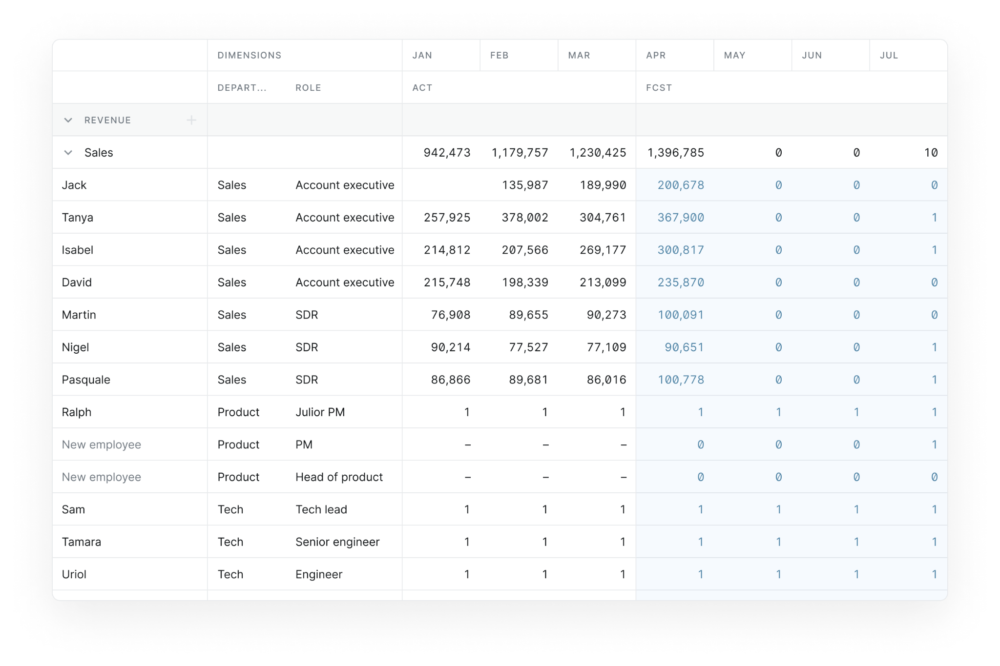
02. FINANCIALS
Headcount
Notes:
On this slide, talk about what your org chart looks like now and how you envision it in the future. Discuss recent hires and planned hires for the coming quarter.

Slide 15
Sales Updates

Slide 16
KPIs: Last Quarter
03. SALES UPDATES
Last quarter’s new ARR by deals and contract size
New business vs. renewals
Expansion vs. contraction
Q1 2022 DEALS CLOSED
Account | Type | Status | New ARR Booked
Alpha | New | W | 80,000
Bravo | New | W | 70,000
Charlie | New | W | 100,000
Delta | New | L
Eho | Expansion | W | 10,000
Foxtrot | Expansion | W | 20,000
Golf | Expansion | L
Hotel | Renewal | W | 60,000
India | Renewal | W | 50,000
Juliet | Renewal | L
Kilo | Contraction | L | -10,000
Lima | Contraction | L | -10,000
Papa | Churn | L | -20,000

Slide 17
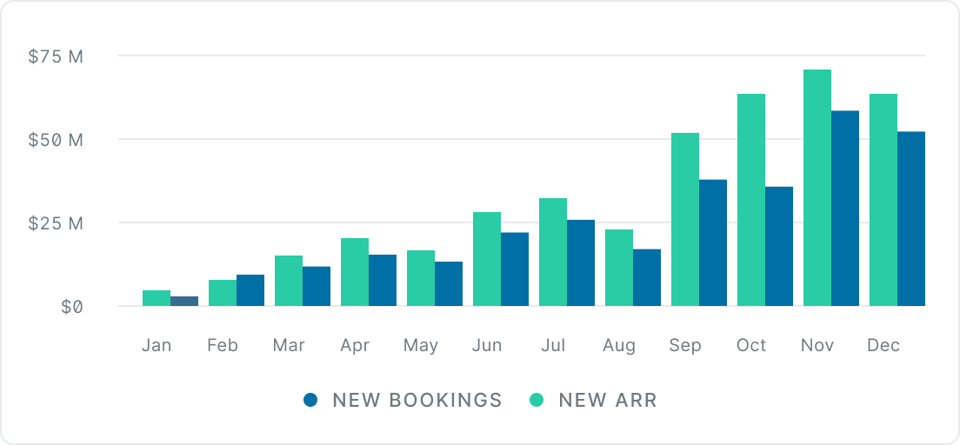
03. SALES UPDATES
Bookings
Notes:
KPIs help paint a clear picture of how an organization is performing. By checking the health of a business, leaders within an organization can see where they are succeeding and where they need to improve.

Slide 18
03. SALES UPDATES
KPI Pipeline
Account | Stage | Amount | Probability | Weighted Amount | Close Date
Alpha | Lead | $100,000 | 20% | $10,000 | Aug 21
Bravo | Lead | $50,000 | 20% | $7,500 | Jul 21
Charlie | Lead | $75,000 | 20% | $18,750 | Jul 21
Delta | Lead | $150,000 | 20% | $37,500 | Jul 21
Echo | Qualification | $200,000 | 40% | $80,000 | Jun 21
Foxtrot | Qualification | $75,000 | 40% | $30,000 | Jun 21
Golf | Qualification | $150,000 | 40% | $60,000 | May 21
Hotel | Demo | $75,000 | 60% | $45,000 | May 21
India | Demo | $150,000 | 60% | $90,000 | May 21
Juliet | Negotiation | $200,000 | 80% | $160,000 | Apr 21
Kilo | Negotiation | $150,000 | 80% | $120,000 | Apr 21
Lima | Proposal | $120,000 | 90% | $108,000 | Apr 21
TOTAL WEIGHTED SALES PIPELINE IN Q2 |  | $1,120,000 |  | $693,000
Notes:
KPIs help paint a clear picture of how an organization is performing. By checking the health of a business, leaders within an organization can see where they are succeeding and where they need to improve.

Slide 19
03. SALES UPDATES
Pipeline Generation
PIPELINE OVERVIEW
Stage | # of accounts | QoQ Change % | Weighted total pipeline ($000s)
Interested | 1,000 | 25% | n/a
Lead | 470 | 30% | 400
Qualification | 200 | 40% | 600
Demo | 80 | 50% | 400
Negotiation | 45 | 60% | 300
Proposal | 40 | 40% | 250
Notes:
KPIs help paint a clear picture of how an organization is performing. By checking the health of a business, leaders within an organization can see where they are succeeding and where they need to improve.

Slide 20
03. SALES UPDATES
Forecast: ARR
Forecast
Beat Original Plan
Missed Original Plan
 |  | Jan-22 | Feb-22 | Mar-22 | Apr-22 | May-22 | Jun-22 | Jul-22 | Aug-22 | Sep-22 | Oct-22 | Nov-22 | Dec- 22
Original Plan |  | 700 | 880 | 1,200 | 1,350 | 1,550 | 1,720 | 1,800 | 1,980 | 2,100 | 2,250 | 2,450 | 2,660
New Forecast | Jan-22 | 700 | 880 | 1,200 | 1,350 | 1,550 | 1,720 | 1,800 | 1,980 | 2,100 | 2,250 | 2,450 | 2,660
 | Feb-22 |  | 890 | 1,200 | 1,350 | 1,600 | 1,750 | 1,800 | 1,980 | 2,100 | 2,250 | 2,450 | 2,660
 | Mar-22 |  |  | 1,195 | 1,350 | 1,600 | 1,700 | 1,780 | 1,980 | 2,100 | 2,250 | 2,450 | 2,660
 | Apr-22 |  |  |  | 1,350 | 1,600 | 1,700 | 1,800 | 1,980 | 2,100 | 2,250 | 2,450 | 2,660
 | May-22 |  |  |  |  | 1,500 | 1,680 | 1,800 | 1,980 | 2,100 | 2,250 | 2,450 | 2,660
 | Jun-22 |  |  |  |  |  | 1,650 | 1,800 | 1,980 | 2,100 | 2,250 | 2,450 | 2,660
 | Jul-22 |  |  |  |  |  |  | 18,300 | 1,980 | 2,100 | 2,250 | 2,450 | 2,660
 | Aug-22 |  |  |  |  |  |  |  | 1,990 | 2,100 | 2,250 | 2,450 | 2,660
 | Sep-22
 | Oct-22
 | Nov-22
 | Dec-22
Notes:
Consider using a waterfall chart to track topline forecast over time.This encourages the finance team to reforecast on a regular basis. By taking this approach, all functions are able to stay up-to-date and align on the same goals.

Slide 21
03. SALES UPDATES
KPI Pipeline
Sales Rep | Deals Closed | Bookings | New ARR | Bookings Quota | Quota Attained
Sales Rep 1 | 8 | $150,000 | $75,000 | $120,000 | 125%
Sales Rep 2 | 6 | $70,000 | $50,000 | $60,000 | 117%
Sales Rep 3 | 7 | $110,000 | $80,000 | $100,000 | 110%
Sales Rep 4 | 9 | $85,000 | $50,000 | $80,000 | 106%
Sales Rep 5 | 4 | $100,000 | $50,000 | $100,000 | 100%
Sales Rep 6 | 3 | $180,000 | $90,000 | $200,000 | 90%
Sales Rep 7 | 3 | $40,000 | $40,000 | $50,000 | 80%
Sales Rep 8 | 2 | $35,000 | $30,000 | $50,000 | 70%
Sales Rep 9 | 2 | $60,000 | $55,000 | $100,000 | 60%
Sales Rep 10 | 2 | $75,000 | $65,000 | $150,000 | 50%
Notes:
When reporting on sales rep performance, consider demonstrating through quota attainment. This slide is also a great opportunity to discuss other needs or roadblocks of the sales team and how these factors may influence performance.

Slide 22
Product Updates

Slide 23
Latest Releases:
03. PRODUCT UPDATES
Product Priorities
Impact:
Tech improvement #1
Tech improvement #2
Tech improvement #3
Wins
Delays
Objectives achieved

Slide 24
03. PRODUCT UPDATES
Product Roadmap
 | Q1 |  |  | Q2 |  |  | Q3 |  |  | Q4
 | Jan | Feb | Mar | Apr | May | Jun | July | Aug | Sep | Oct | Nov | Dec
1 | Key feature #1
2 |  | Key feature #2
3 |  |  |  | key feature #3
4 |  |  |  |  |  |  | Key feature #4
5 |  |  |  |  |  |  |  |  | Key feature #5

Slide 25
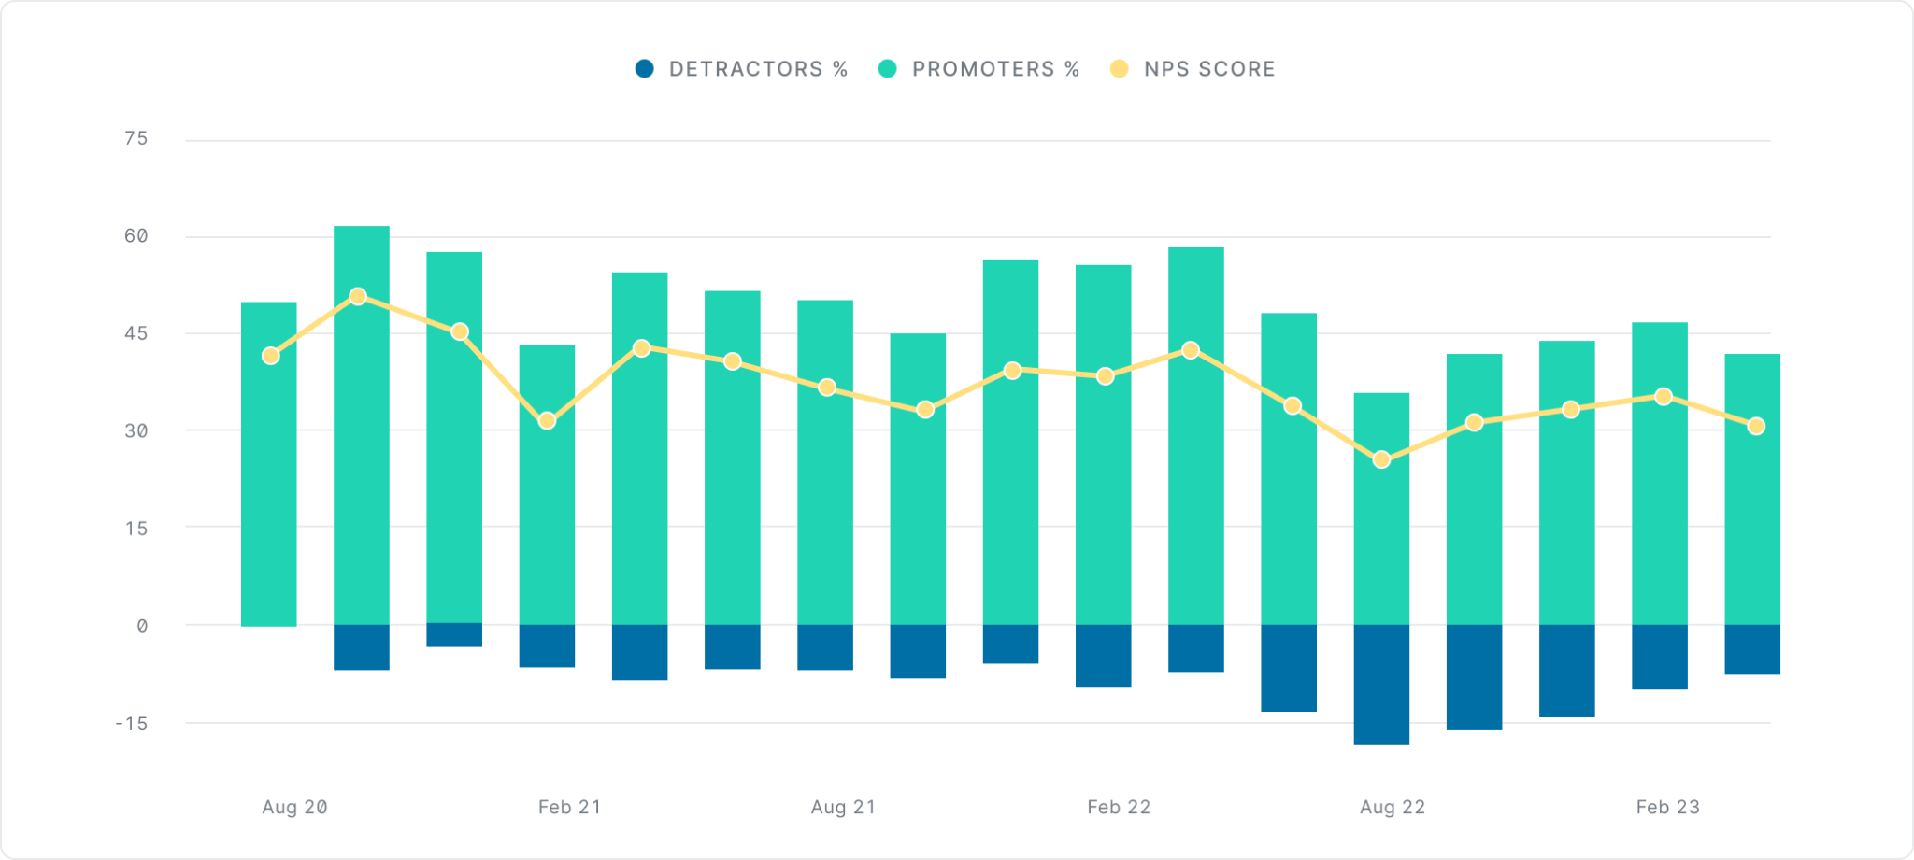
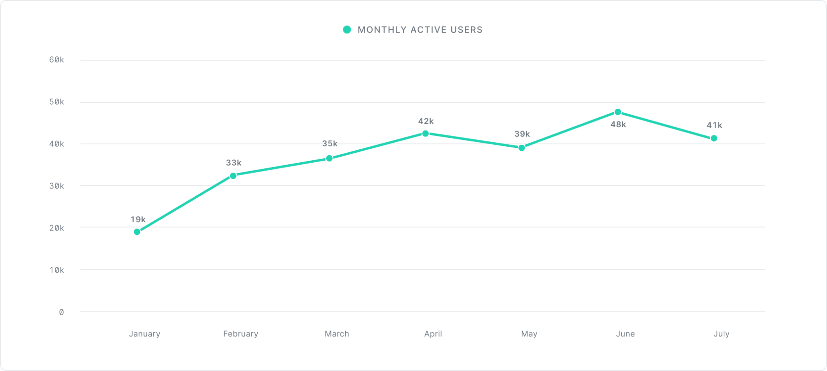
03. PRODUCT UPDATES
Engagement

Slide 26
Marketing Updates

Slide 27
Priorities for the quarter
03. MARKETING UPDATES
Marketing events
01
02
Campaign review
Marketing Milestones
03
New initiatives
04
Current challenges / roadblocks
Notes:
If Marketing has just hosted an event, this is a great opportunity to discuss how it went and what the results were. It is also a good idea to briefly discuss new campaigns, promotions, and results over the last quarter.

Slide 28
Appendix

Slide 29
Thank you.

